Slide 1
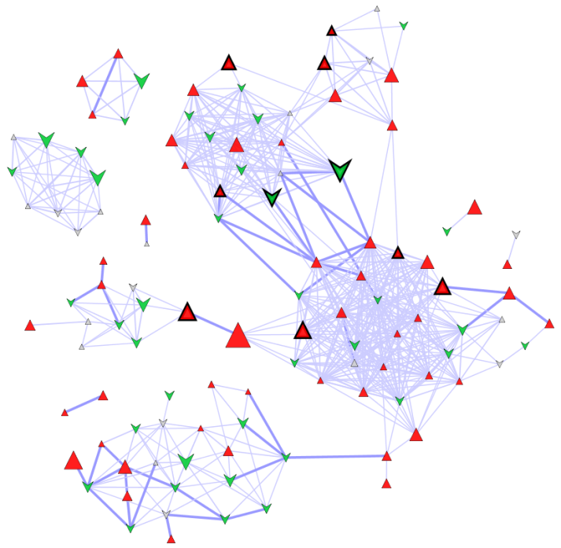
Biochemical and Structural Similarity Network Mapping
Goal: Generate a mapped biochemical product/substrate and chemical similarity network
Topics:
Edge list generation
Node attributes generation
Network Mapping

Slide 2
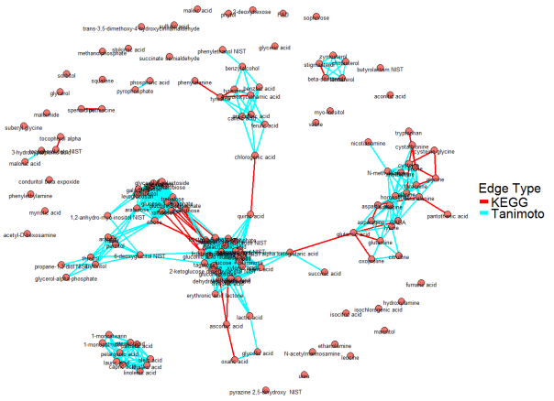
Biochemical and Structural Similarity Network Mapping
Data: Pumpkin and Tomatillo data for network.csv
Steps
Use MetaMapR (see startup.R to launch):
url: https://github.com/dgrapov/MetaMapR
Biochemical and structural similarity based edge list for all metabolites with KEGG and PubChem identifiers.
Network preview
Node attributes
Use previously generated Pumpkin/Tomatillo analysis results to generate node attribute mappings
Visualize and map network using Cytoscape

Slide 3
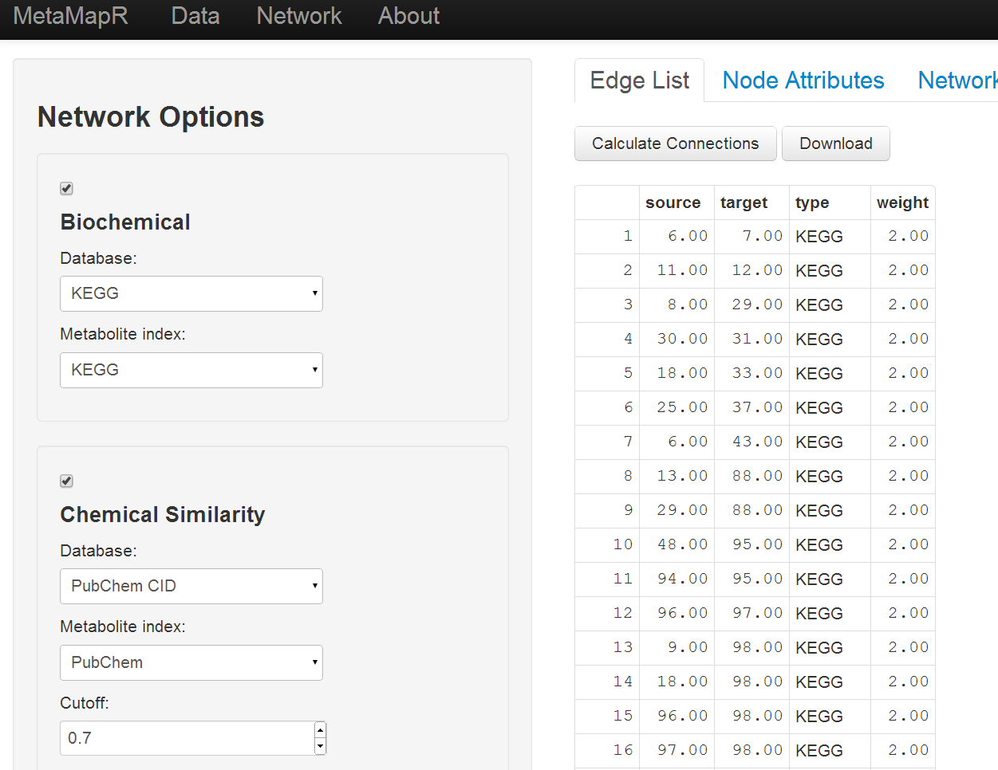
MetaMapR: Edge List
Download the generated edge list, overview and save as an .xlsx file (for ease of import).

Slide 4

Preview Network

Slide 5
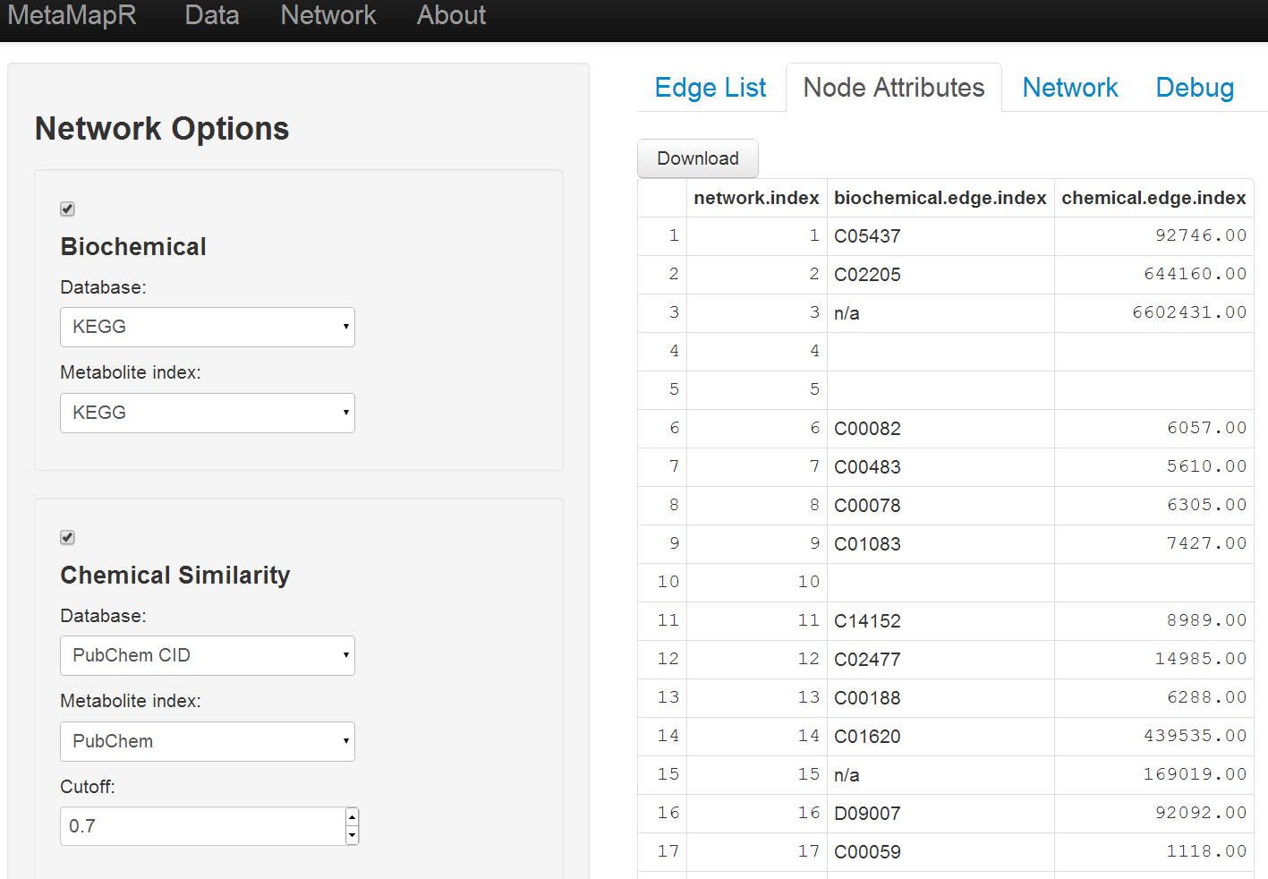
Node Attributes

Slide 6
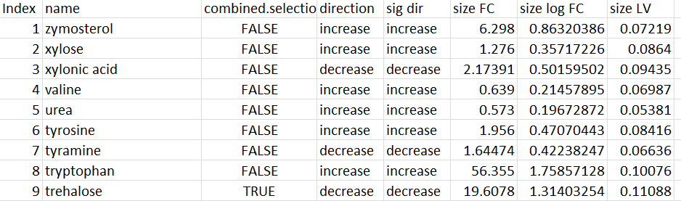
Mapping Analysis results to Node Attributes
Labels: metabolite names
Shape: Direction of change relative to pumpkin
Index matching edge list ID
Color: Direction of change for significantly changed species (t-Test)
Border: O/PLS/-DA selected feature?
Size(a): log of the magnitude of fold change
Size(b): O/PLS/-DA LV 1 loadings

Slide 7
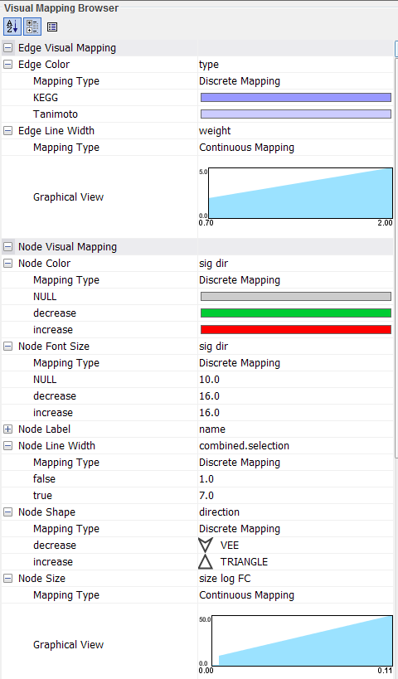

Mapping in cytoscape

Slide 8
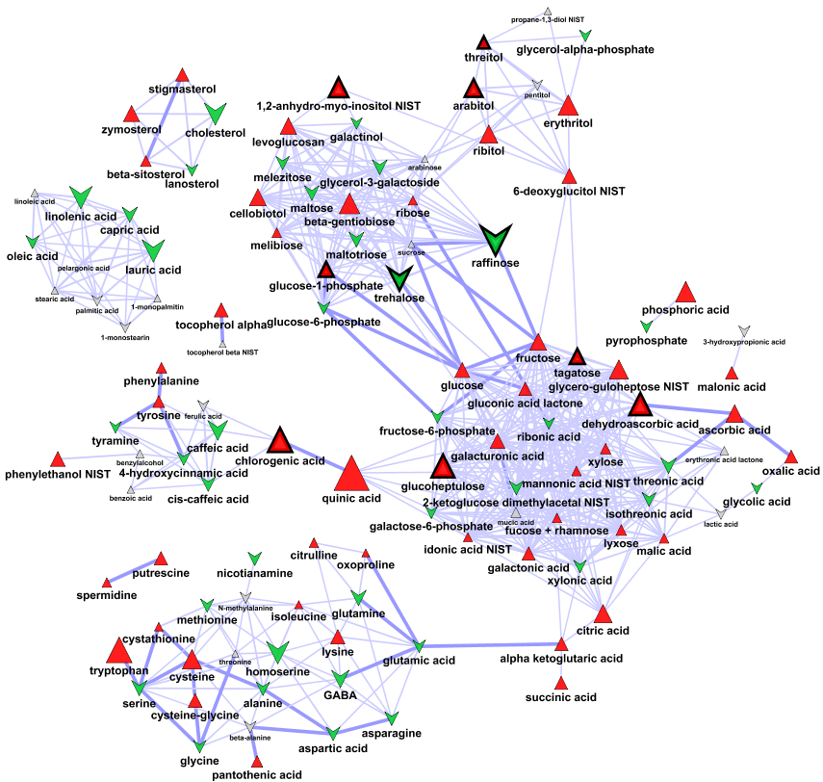
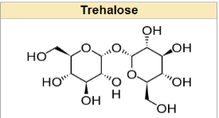
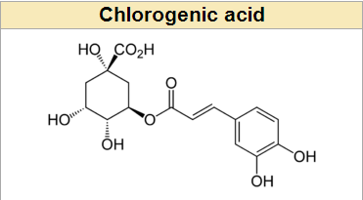
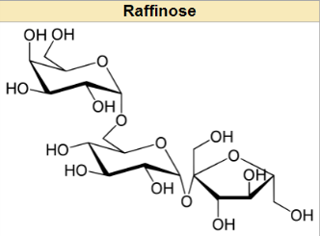
Biochemical and Spectral Similarity Mapped Network for: Differences in Pumpkin and Tomatillo Leaf Primary Metabolites
Leaf fatty acids are decreased and phytosterols increased in tomatillo compared to pumpkin
Tomatillo displays a general increases in leaf carbohydrates with the exception of raffinose and trehalose, which are importantly decreased in tomatillo compared to pumpkin
Helps withstand prolonged periods of desiccation
intermediate for lignin synthesis, related to quinic acid which is an astringent
A trisaccharide, can not be digested by humans, but readily fermented by bacteria

Slide 9

Summary
View all files and mappings used in the network construction in the:
Data folder
Pumpkin and Tomatillo data for network.csv
Network folder
Biochemical edge list.xlsx
Biochemical node attributes.xlsx
Biochemical network.cys (final network)

